Slide 1
Time to retire ‘No trace wrong place’
Tim Cook
Airways Lead meeting
RCoA 28 March 2025

Slide 2
Conflicts
Author of the
No trace wrong place
campaign
Author of the
PUMA guidelines

Slide 3
History
32,000 views

Slide 4
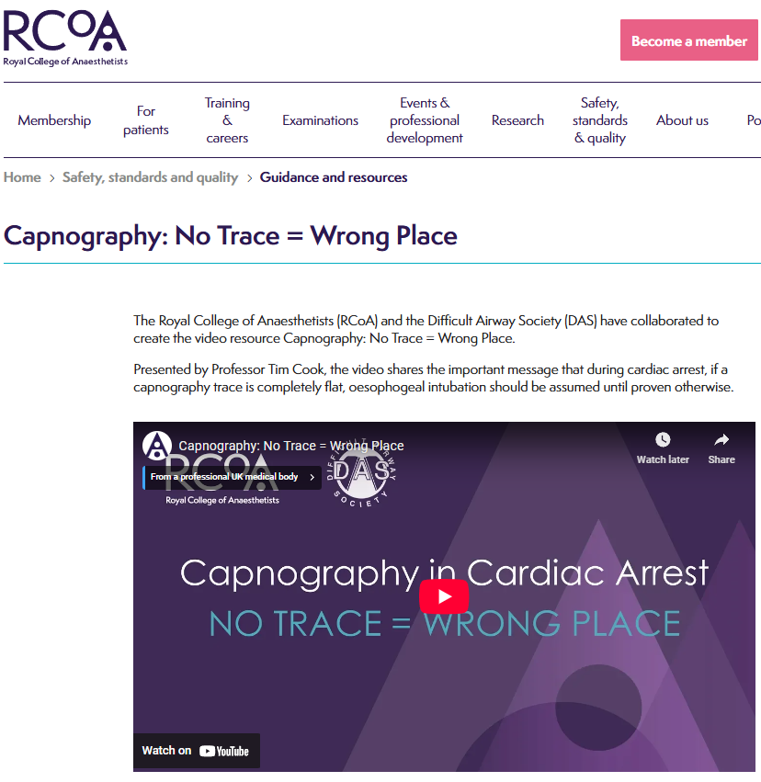
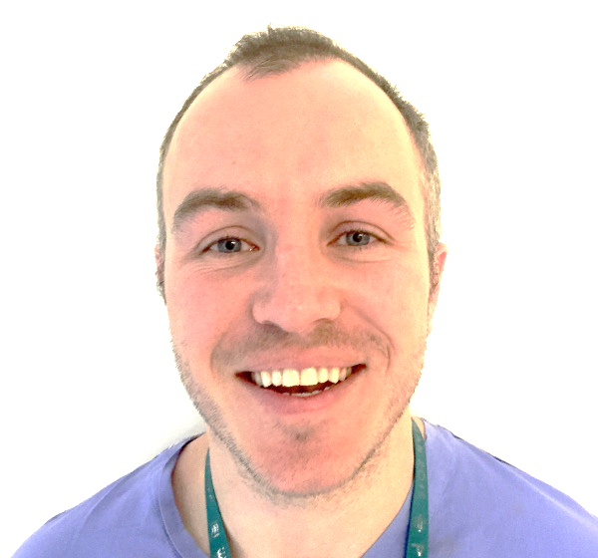
History
In the wake of coroner’s reports on death of Sharon Grierson & Peter Saint
Term coined in this room by Lewys Richmond
RCoA video 2018
Still on website

Slide 5
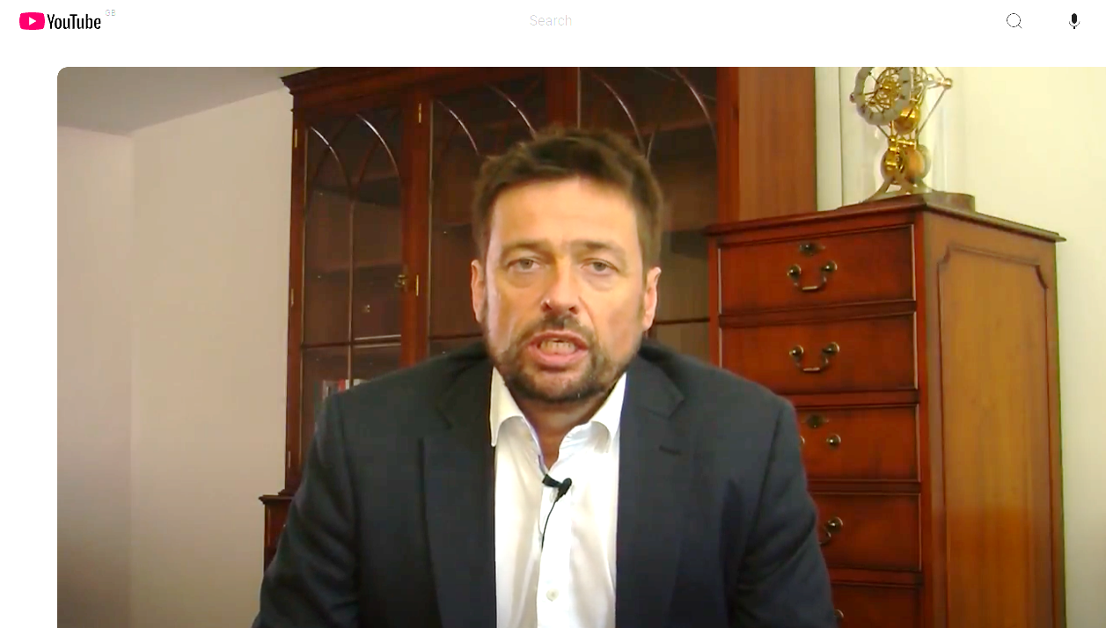
History
32,000 views

Slide 6
History
32,000 views

Slide 7
Nuance

Slide 9
History

Slide 12
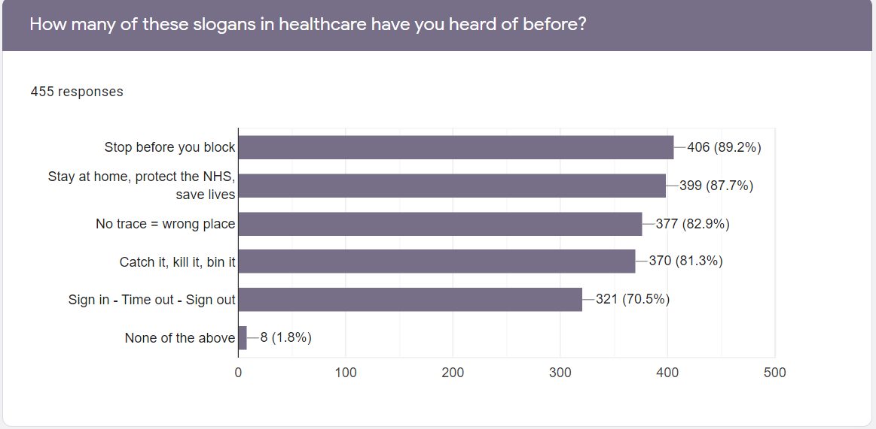
RCoA survey 2022 455 Social media 455 responses

Slide 13
Since 2018 - updated science

Slide 14
Don’t use clinical signs to exclude oesophageal intubation

Slide 15
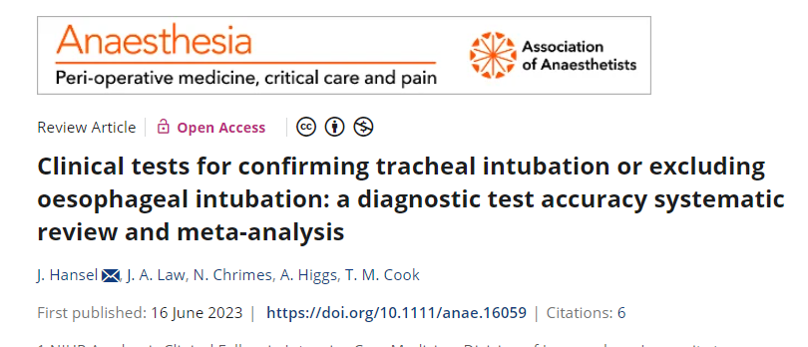
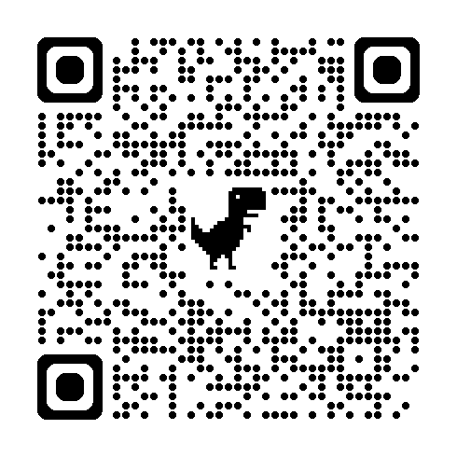

Slide 16
Misting: occurs with 70% of tubes in oesophagus
Auscultation: +ve in 14 -18% when tube in oesophagus
(RCT conditions)
Chest rise: insufficient data
(but clinically frequently rises with tube in oesophagus)

Slide 17
Tests to exclude events that invariably lead to severe damage or death must have a negligible false positive rate.
Misting or auscultation have too high a false positive rate to reliably exclude oesophageal intubation and there is insufficient evidence to support the use of ‘hang-up’ or chest rise.
The oesophageal detector device may be considered where other more reliable means are not available.
Waveform capnography remains the reference standard for confirmation of tracheal intubation.

Slide 18
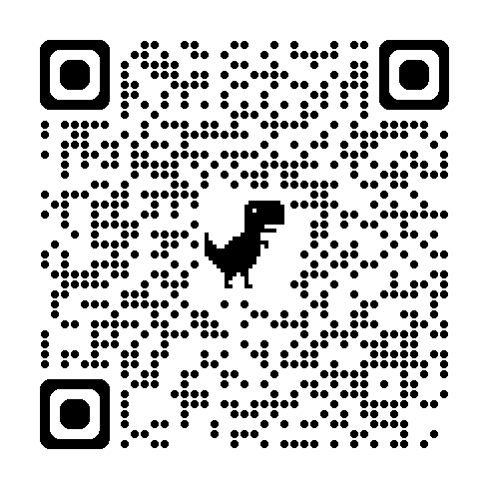
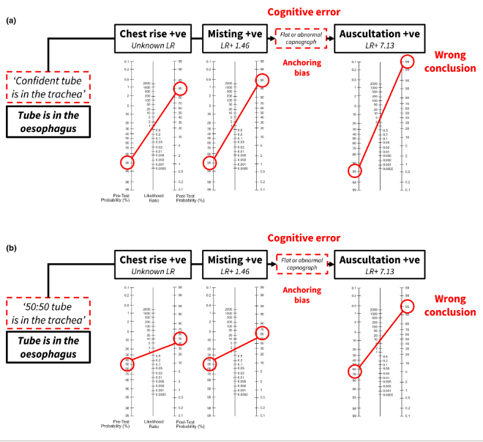
The dangerous fallacy
“I’ve got chest rise and misting ….. ….now I’ll look at the capnograph”

Slide 19
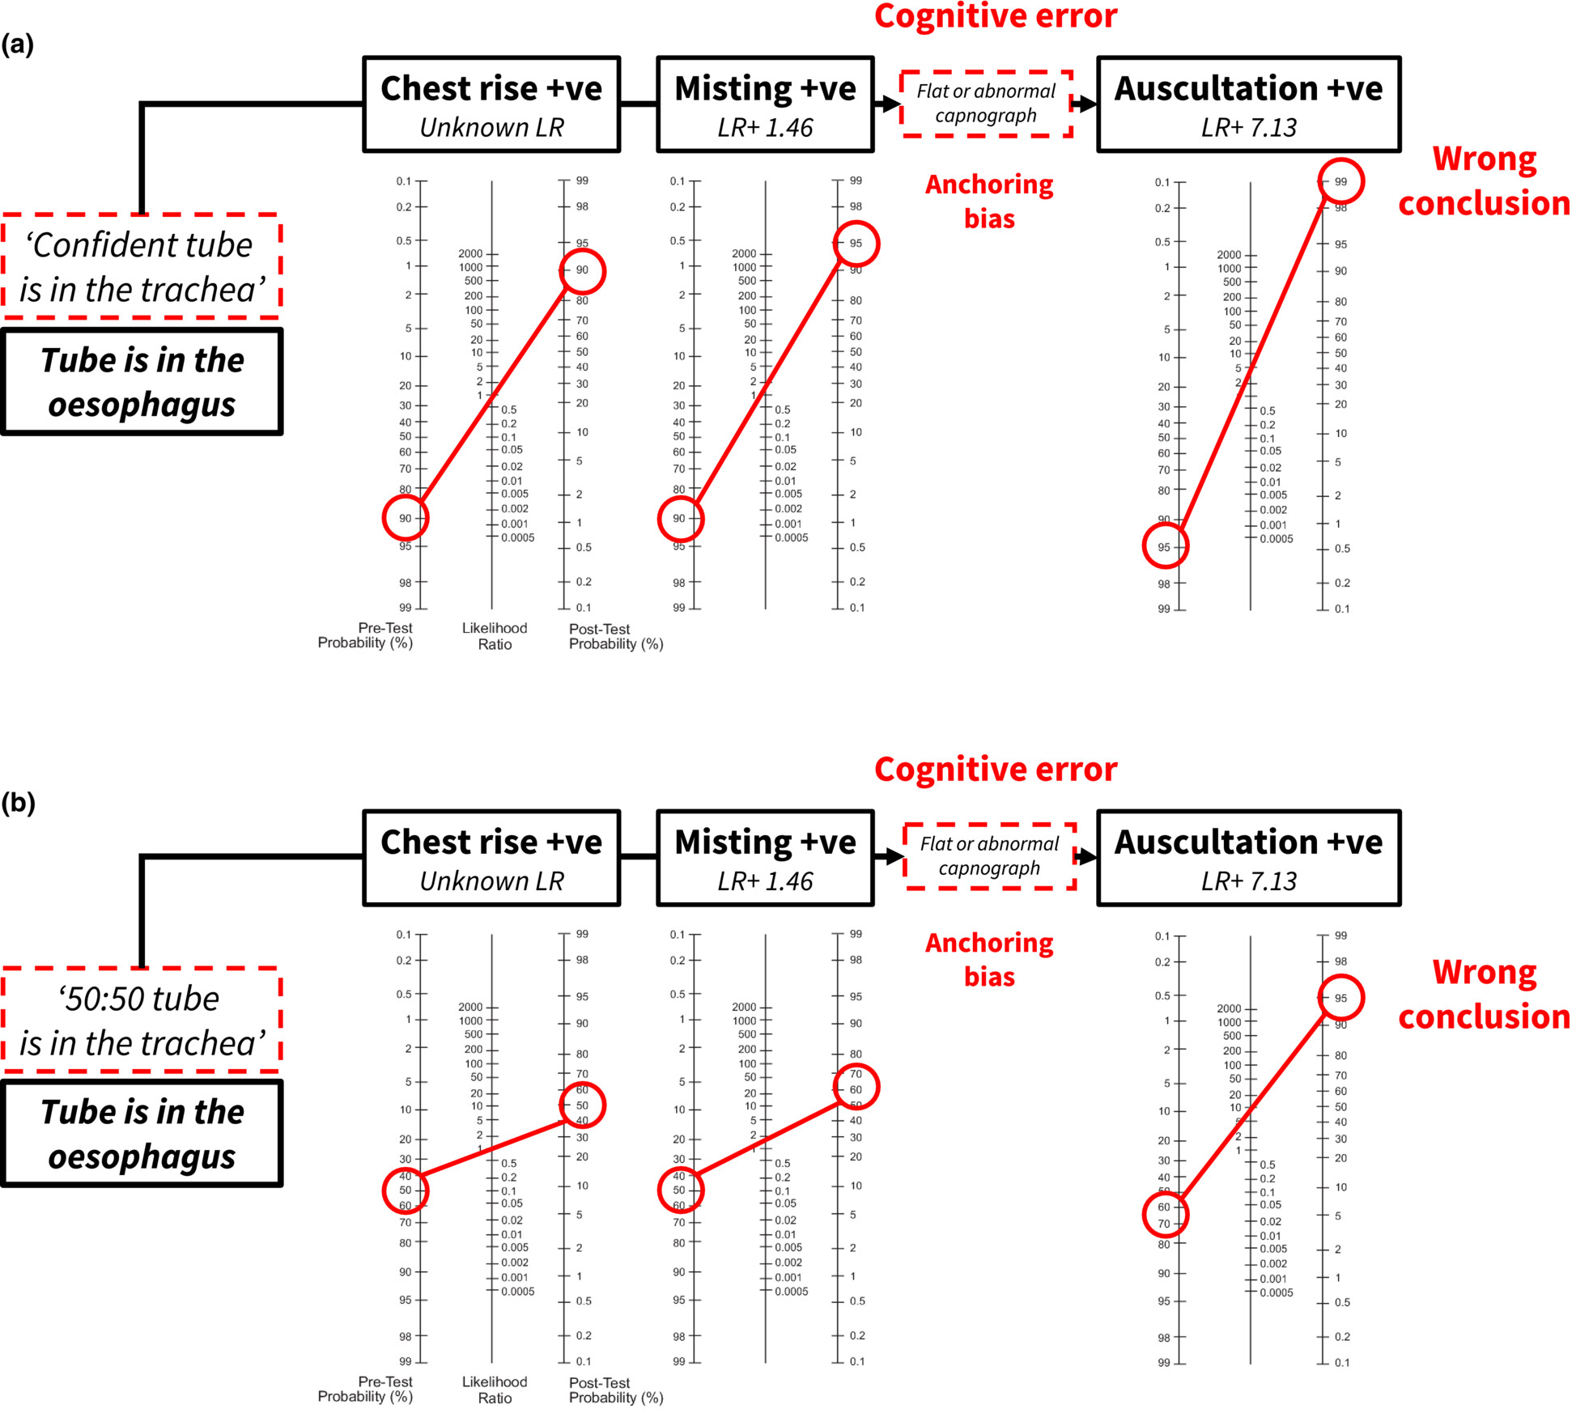
The dangerous fallacy
“I’ve got misting and chest rise….. ….now I’ll look at the capnograph”

Slide 20
The dangerous fallacy
“I’ve got misting and chest rise….. ….now I’ll look at the capnograph”

Slide 21
Do use a VL (always)

Slide 22
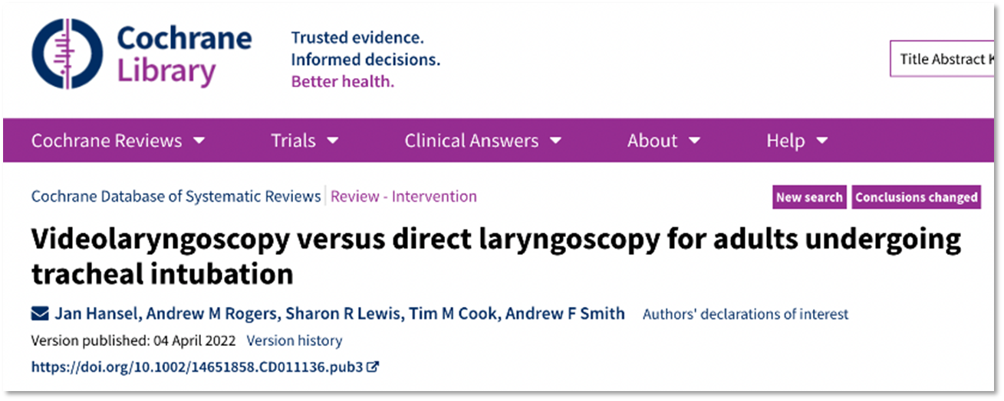
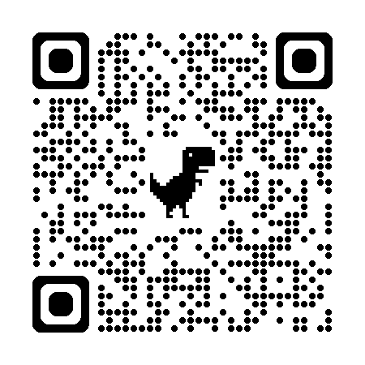

Slide 23
Population
Adults > 16 years
Intervention
Rigid indirect videolaryngoscopy
Comparison
Direct laryngoscopy – Macintosh blade only
Outcomes - Critical
Failed intubation
Hypoxia
Successful first attempt
Oesophageal intubation
Outcomes - Important
Dental trauma
Number of attempts
Patient-reported sore throat
Time for tracheal intubation
IDS score
POGO
Cormack-Lehane grade
Mortality
3605 records from database searching
686 records from trials register searching
33 records excluded from 2016 review
12 records
from forward & backward citation searching
2344 records screened
2044 records excluded
Videolaryngoscopy versus direct laryngoscopy for adults undergoing tracheal intubation
300 full-text articles assessed for eligibility
69 full-text articles excluded
46 ongoing studies
27 studies awaiting classification
64 studies from previous review
158 new studies included
222 studies included
26149 participants

Slide 24
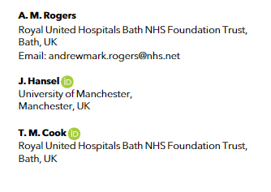
40 studies reported oesophageal intubation
29 in theatre
11 non-theatre
Definition?
Early vs late detection
https://associationofanaesthetists-publications.onlinelibrary.wiley.com/doi/epdf/10.1111/anae.15818

Slide 25
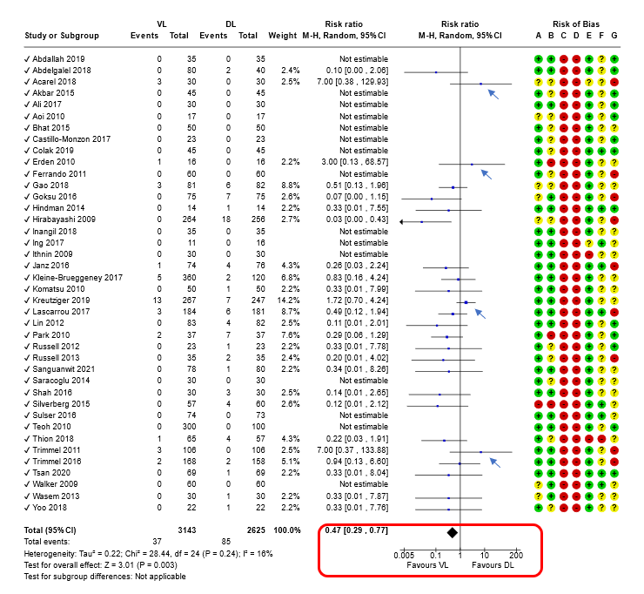
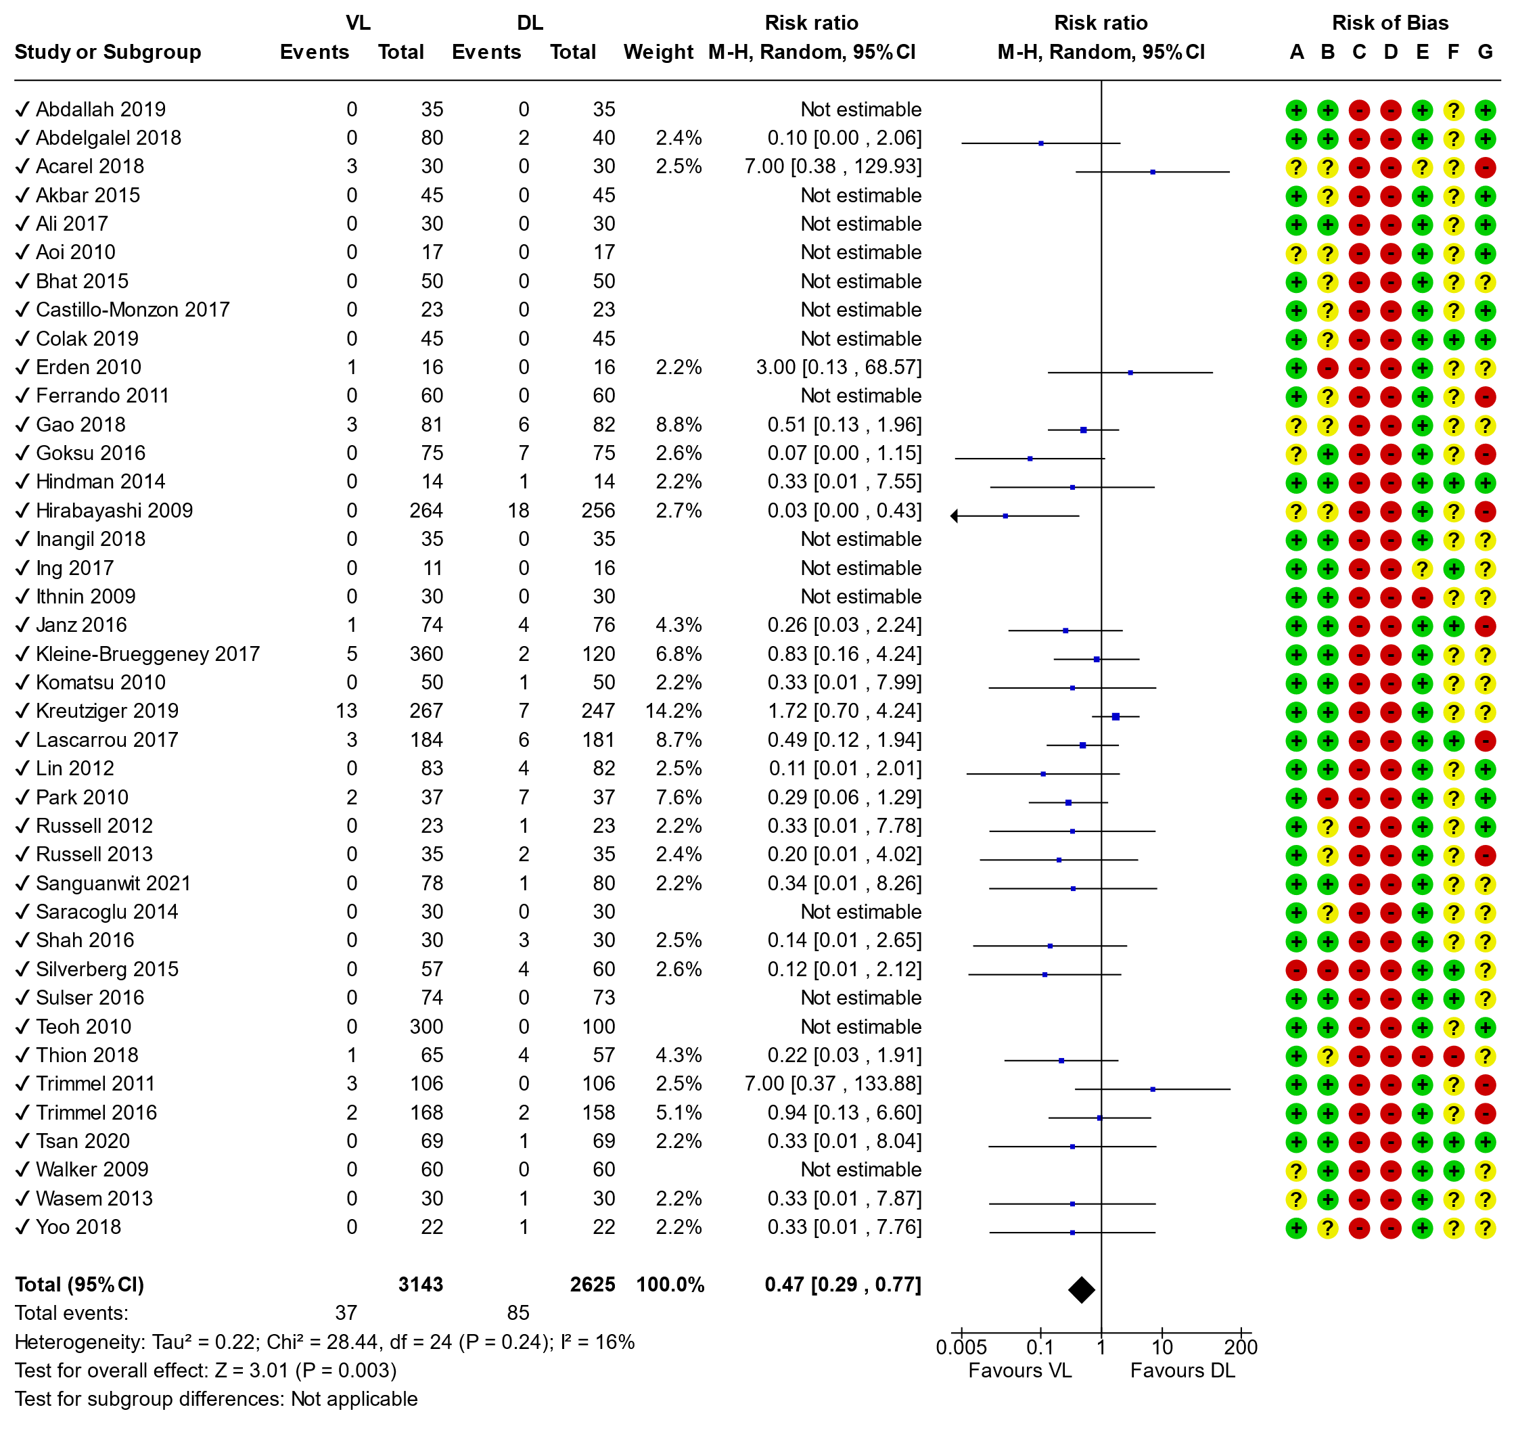
All VL combined
Relatively rare
Incidence approx 1% for VL vs 3% with DL
Excluding non-theatre studies: 0.6% vs 3.2%
Consistent with rates reported in other studies^{1,2}
Pedersen TH, Ueltschi F, Hornshaw T, et al. Optimisation of airway management strategies: a prospective before-and-after study on events related to airway management. British Journal of Anaesthesia 2021; 127: 798-806.
Huitink JM, Lie PP, Heideman I, et al. A prospective, cohort evaluation of major and minor airway management complications during routine anaesthetic care at an academic medical centre. Anaesthesia 2017; 72: 42-8.

Slide 26
Oesophageal intubation in RCTs
DL 3%
VL 1%

Slide 27
Unrecognised oesophageal intubation An ongoing issue?

Slide 28
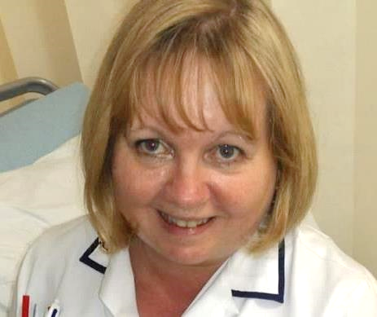
Glenda Logsdail
Healthy mother of two
Married
Radiographer
August 2020
Acute appendicitis
Low risk surgery

Slide 29
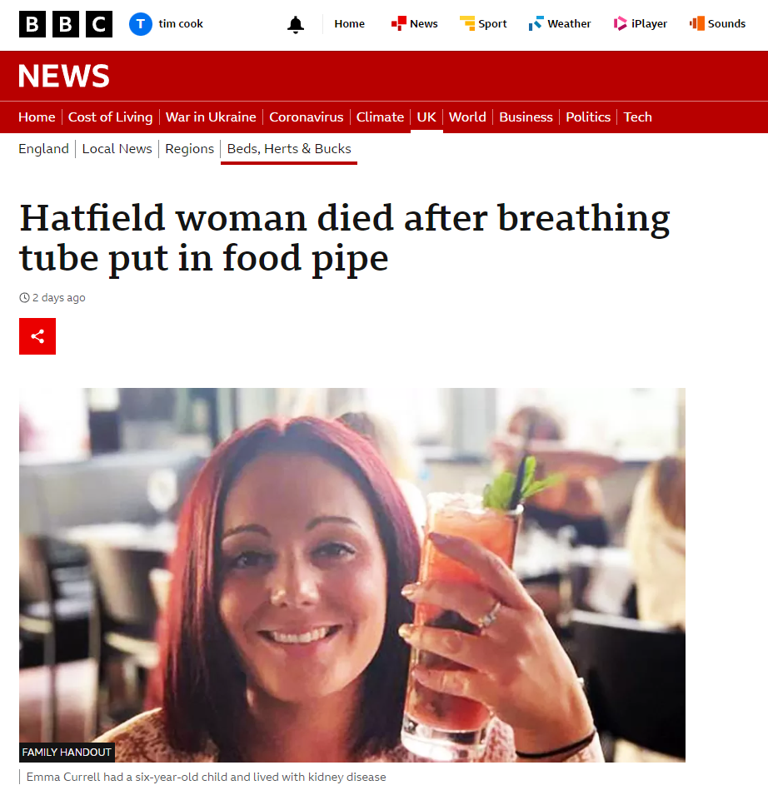
Emma Currell 2020 reported 2023
https://www.bbc.co.uk/news/uk-england-beds-bucks-herts-64789531

Slide 30
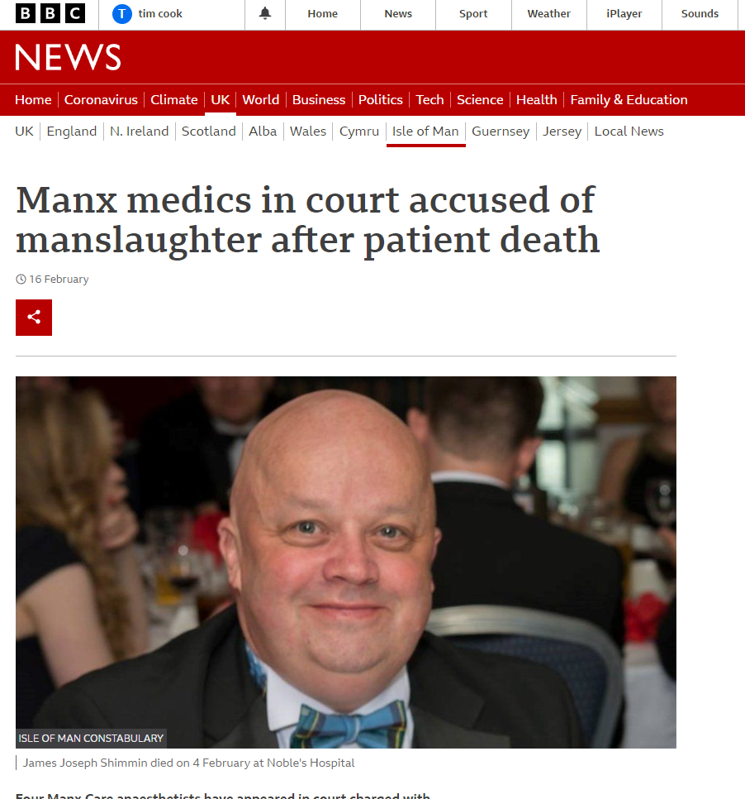
https://www.bbc.co.uk/news/world-europe-isle-of-man-60403776
James Schimmin
Feb 2021
Four anaesthetists arrested
Charged with manslaughter

Slide 31
Joseph Parker Unrecognised oesophageal intubation - not reported as such - inquest May 2024 - no PFD report
https://uk.news.yahoo.com/gifted-student-joseph-parker-died-111646898.html

Slide 32
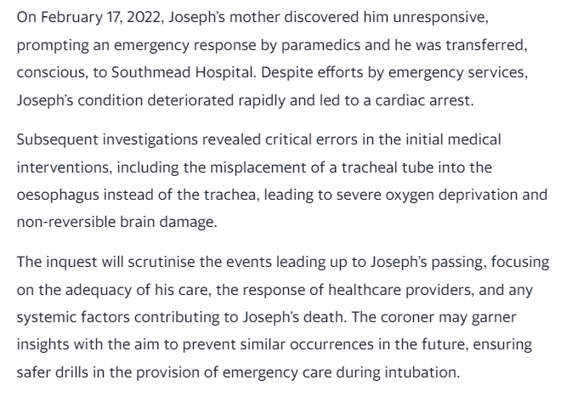
UOI – not reported as such
https://uk.news.yahoo.com/gifted-student-joseph-parker-died-111646898.html

Slide 33
Joseph Parker Unrecognised oesophageal intubation - not reported as such - inquest May 2024 - no PFD report
https://uk.news.yahoo.com/gifted-student-joseph-parker-died-111646898.html

Slide 34
PUMA

Slide 35
Read and know the PUMA guidelines
Notes:
Most important thing I can tell you in this presentation: read the guideline. If you just listen to this presentation or read the key points, even if you agree with all of them, you will undermine your ability to use it to help make your patients safer.

Slide 36
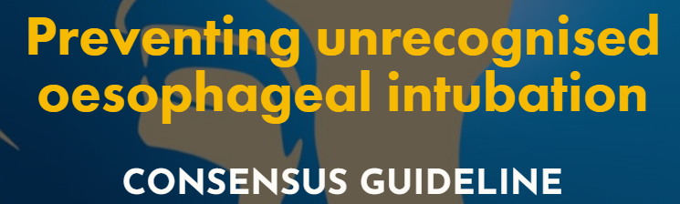
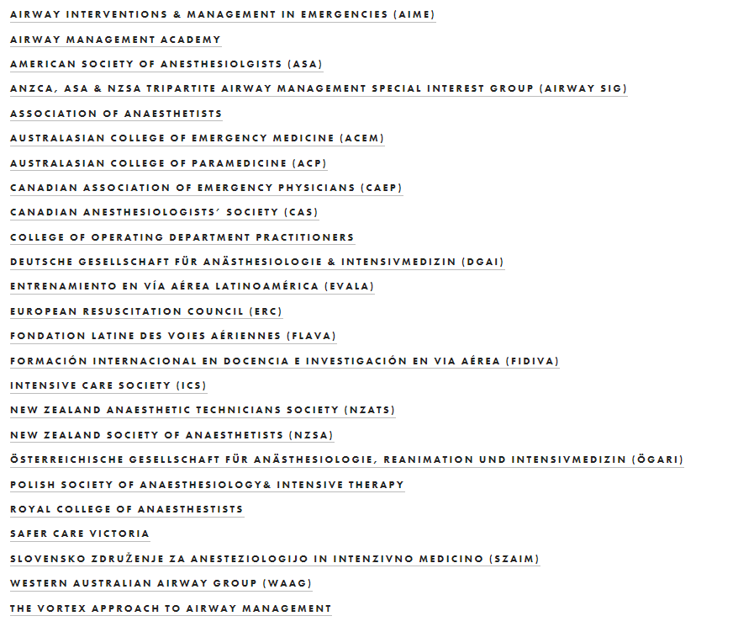
Endorsed
PUMA
Supported

Slide 37
Endorsed
PUMA
Supported

Slide 38
Principles
It happens to anyone
Safety first
If in doubt, take it out - go to a ‘place of safety’
Be prepared to be wrong
Work as a team

Slide 39
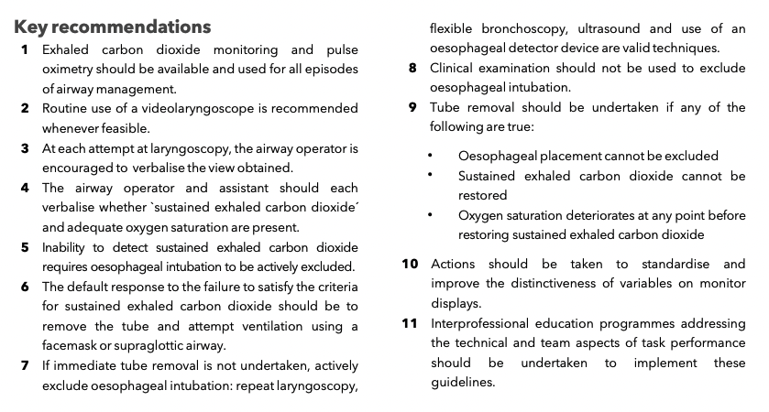

Slide 40
It is all about sustained exhaled capnography
-Level rises during exhalation & falls during inspiration
-Consistent or increasing amplitude over 7 breaths
-Peak amplitude > 1kPa (7.5 mmHg) above baseline
-Reading is clinically appropriate

Slide 41
It is all about sustained exhaled carbon dioxide

Slide 42
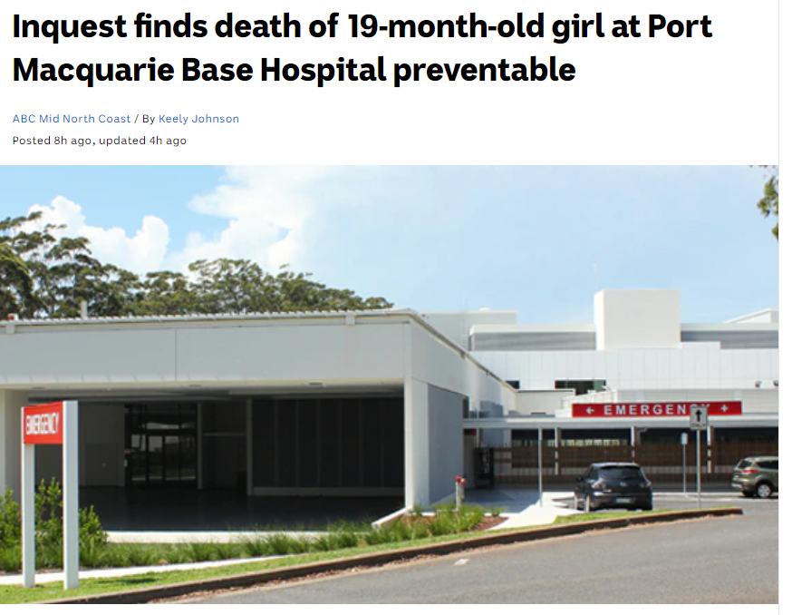
Problems – NTWP is not sufficient
Many UOI do have ‘a trace’

Slide 43
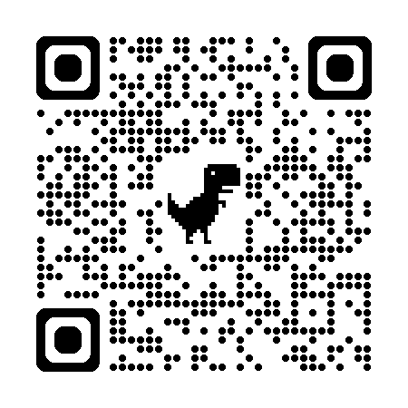
Problems – confusion ‘no trace = not always the wrong place’
BJA 2025: 134; 248-249

Slide 44
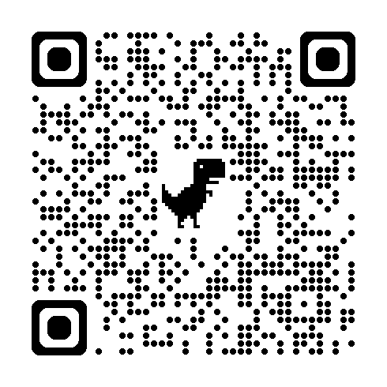
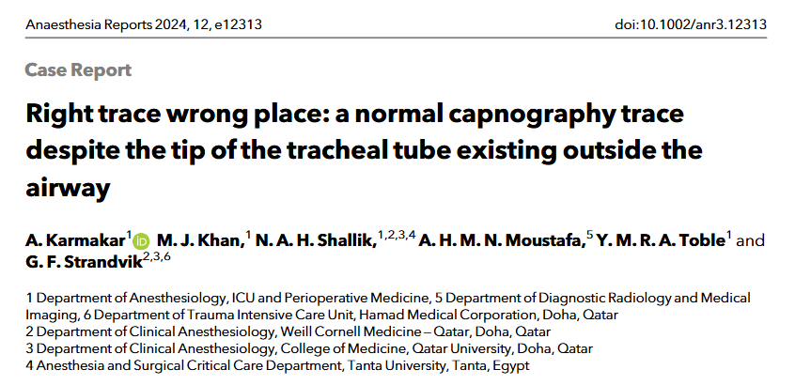
Problems – confusion ‘have a trace = right place’

Slide 45
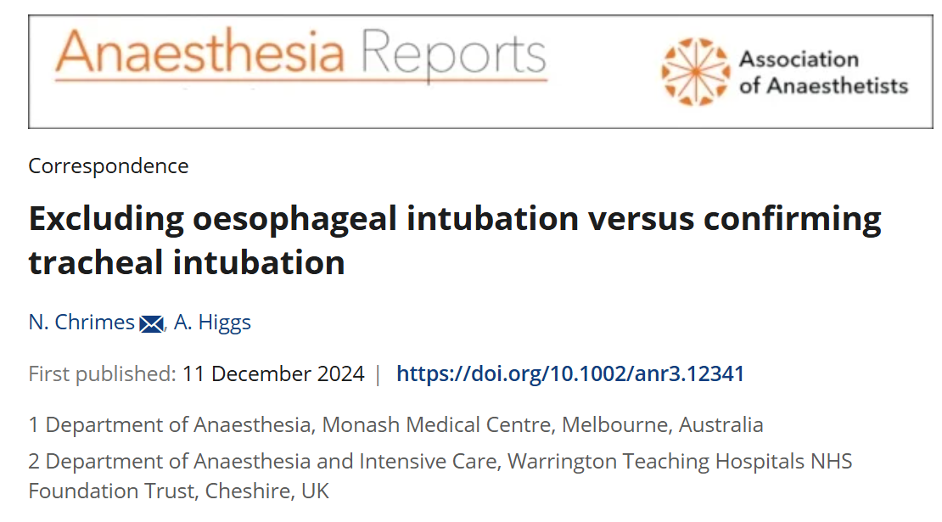
Time to retire

Slide 46
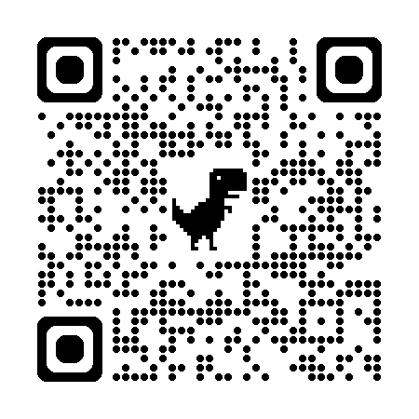
Time to retire NTWP
https://www.bjanaesthesia.org/article/S0007-0912(24)00782-7/abstract

Slide 47
Unrecognised oesophageal intubations in the academic and grey literature
Captured by
No trace wrong place
Captured by
Sustained Exhaled CO₂

Slide 48
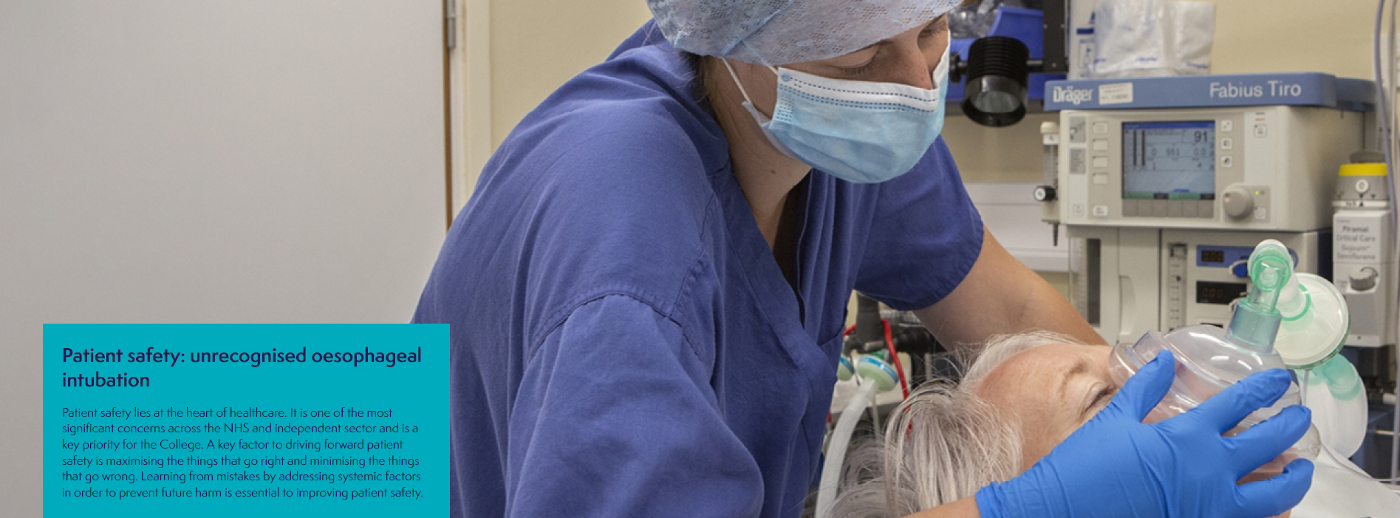
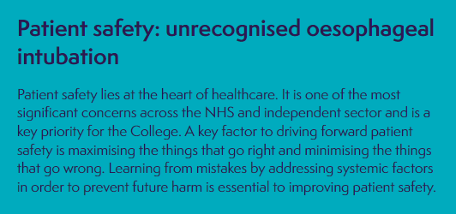
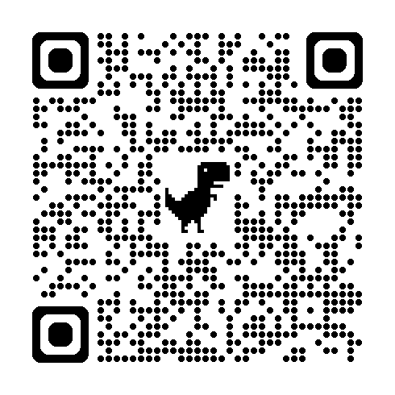
https://www.rcoa.ac.uk/safety-standards-quality/patient-safety/prevention-future-deaths

Slide 51
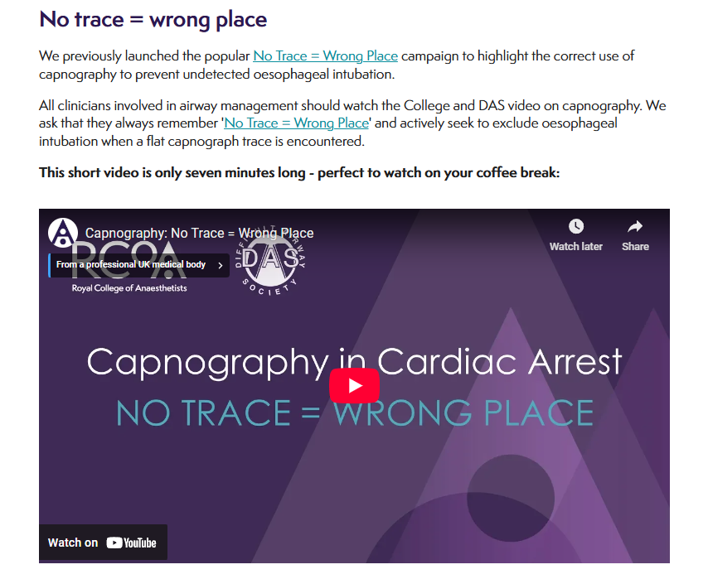

Slide 52
Joseph Parker Unrecognised oesophageal intubation No PFD letter… initially - not reported as such - inquest May 2024 - no PFD report
https://uk.news.yahoo.com/gifted-student-joseph-parker-died-111646898.html

Slide 53
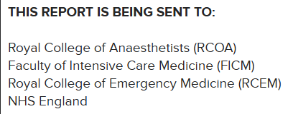
Problems

Slide 54
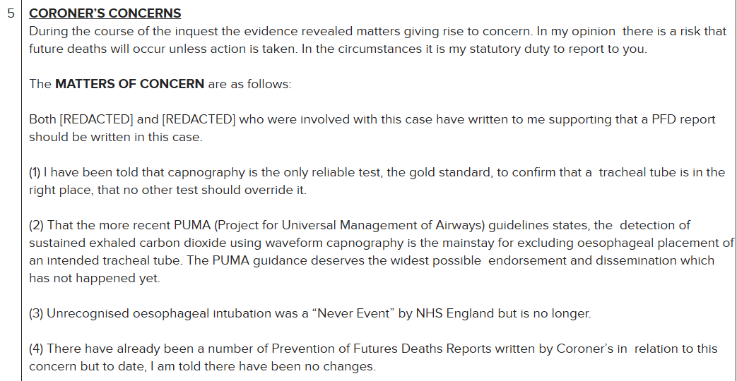

Slide 55
https://www.judiciary.uk/wp-content/uploads/2024/07/2024-0389-Response-from-Association-of-Anaesthetists-RCOA-and-Faculty-of-Intensive-Care-Medicine-Joint-Respons.pdf

Slide 56
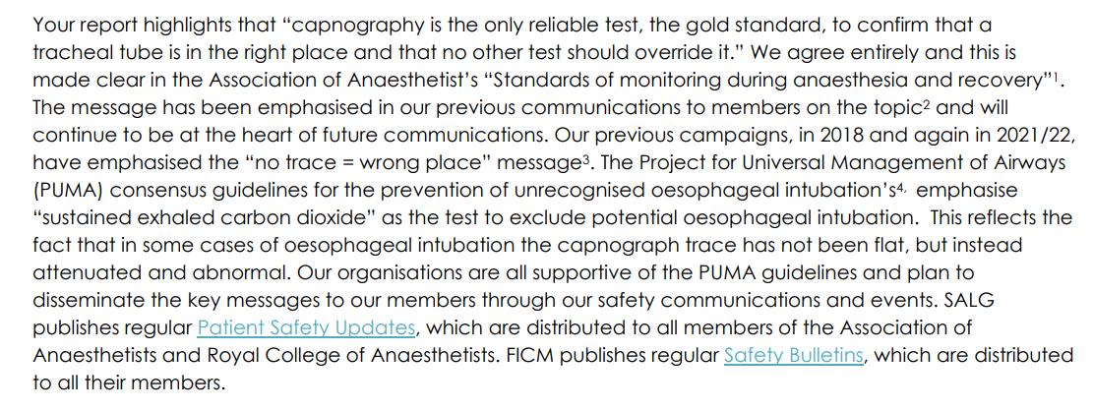
https://www.judiciary.uk/wp-content/uploads/2024/07/2024-0389-Response-from-Association-of-Anaesthetists-RCOA-and-Faculty-of-Intensive-Care-Medicine-Joint-Respons.pdf

Slide 57
Our previous campaigns, in 2018 and again in 2021/22, have emphasised the “no trace = wrong place” message. The Project for Universal Management of Airways (PUMA) consensus guidelines for the prevention of unrecognised oesophageal intubation’s, emphasise “sustained exhaled carbon dioxide” as the test to exclude potential oesophageal intubation. This reflects the fact that in some cases of oesophageal intubation the capnograph trace has not been flat, but instead attenuated and abnormal. Our organisations are all supportive of the PUMA guidelines and plan to disseminate the key messages to our members through our safety communications and events.
https://www.judiciary.uk/wp-content/uploads/2024/07/2024-0389-Response-from-Association-of-Anaesthetists-RCOA-and-Faculty-of-Intensive-Care-Medicine-Joint-Respons.pdf

Slide 58
Our previous campaigns, in 2018 and again in 2021/22, have emphasised the “no trace = wrong place” message. The Project for Universal Management of Airways (PUMA) consensus guidelines for the prevention of unrecognised oesophageal intubation’s, emphasise “sustained exhaled carbon dioxide” as the test to exclude potential oesophageal intubation. This reflects the fact that in some cases of oesophageal intubation the capnograph trace has not been flat, but instead attenuated and abnormal. Our organisations are all supportive of the PUMA guidelines and plan to disseminate the key messages to our members through our safety communications and events.
https://www.judiciary.uk/wp-content/uploads/2024/07/2024-0389-Response-from-Association-of-Anaesthetists-RCOA-and-Faculty-of-Intensive-Care-Medicine-Joint-Respons.pdf

Slide 59
Our previous campaigns, in 2018 and again in 2021/22, have emphasised the “no trace = wrong place” message. The Project for Universal Management of Airways (PUMA) consensus guidelines for the prevention of unrecognised oesophageal intubation’s, emphasise “sustained exhaled carbon dioxide” as the test to exclude potential oesophageal intubation. This reflects the fact that in some cases of oesophageal intubation the capnograph trace has not been flat, but instead attenuated and abnormal. Our organisations are all supportive of the PUMA guidelines and plan to disseminate the key messages to our members through our safety communications and events.
https://www.judiciary.uk/wp-content/uploads/2024/07/2024-0389-Response-from-Association-of-Anaesthetists-RCOA-and-Faculty-of-Intensive-Care-Medicine-Joint-Respons.pdf

Slide 60
No trace: wrong place
Sustained exhaled carbon dioxide
Pros
Catchy
Cons
Catchiness engenders complacency
Imprecise
Insufficient
Confused
Abused
Pros
Part of an international consensus
Defined
Precise
Sufficient
Cons
A bit of a mouthful

Slide 61
Solution
Retire NTWP
Replace with Sustained exhaled carbon dioxide

